Slide 1


Microfinance Loan & Repayment DBMS
System Architecture, Conceptual ER Model, and Relational Database Schema Design

Slide 2





Problem Identification & Scope
Operational Challenges
System Design Scope
Microfinance Institutions (MFIs) frequently struggle with manual record keeping, high calculation error rates for interest and penalties, delayed loan disbursement tracking, and limited visibility into group repayment performance.
The proposed DBMS encompasses end-to-end management: client and group registration, field officer assignments, loan product configuration, multi-tier approvals, cash/electronic disbursements, automated repayment schedules, and savings account ledgers.

Slide 3






Objectives & Key System Users
Data Integrity
Multi-User Roles
Ledger Automation
Maintain ACID-compliant transaction records across client accounts, ensuring error-free balance ledgers and automated penalty execution.
Support Field Officers (loan collections), Credit Officers (approvals), Branch Managers (oversight), and Clients (account visibility).
Eliminate manual schedule creation through algorithmic principal/interest calculations and real-time default monitoring.

Slide 4
Key Functional Requirements
Client & Group Onboarding: Capture full KYC details, assign client profiles to lending groups, and link groups to specific Field Officers.
Loan Application & Approvals: Allow multi-product loan requests, enforce credit limits, and log formal approval/rejection decisions with timestamped auditor IDs.
Disbursement & Schedule Engine: Generate amortization schedules detailing payment due dates, principal components, and interest breakdowns upon loan disbursement.
Repayments & Savings Ledgers: Process repayments against active schedules, auto-calculate overdue penalties, and record compulsory client savings deposits/withdrawals.

Slide 5

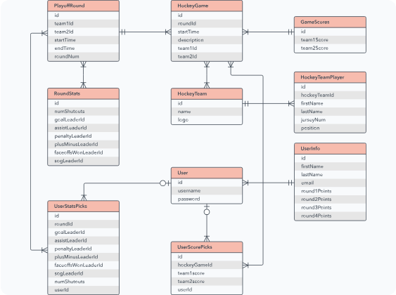
Conceptual Design & ER Model
Entity Relationship Overview
The conceptual model normalizes microfinance operations into 12 core interacting entities:
Clients & Groups: 1 Group contains N Clients; Groups are managed by 1 Field Officer.
Loan Pipeline: 1 Client submits N Applications for a Loan Product; Approved Applications generate 1 active Loan.
Financial Records: 1 Loan creates 1 Disbursement, N Installment Schedules, N Repayments, N Penalties, and connects to 1 Savings Account.

Slide 6

Core Schema: Client & Loans
Table Name | Primary Key | Foreign Keys | Key Attributes & Constraints
Clients | client_id | group_id | first_name, last_name, phone, national_id, kyc_status
Groups | group_id | officer_id | group_name, meeting_day, center_location
Field_Officers | officer_id | branch_id | officer_name, phone, zone_assigned, active_flag
Loan_Products | product_id | None | product_name, interest_rate, min_amount, max_amount
Applications | app_id | client_id, product_id | requested_amount, app_date, status (Pending/Approved)

Slide 7
Financial Schema & Repayments
Table Name | Primary Key | Foreign Keys | Key Attributes & Operational Logic
Loans | loan_id | app_id, officer_id | principal_amount, duration_months, start_date, loan_status
Disbursements | disb_id | loan_id | disb_amount, disb_date, channel (Cash/Bank Transfer)
Schedules | schedule_id | loan_id | due_date, principal_due, interest_due, status (Paid/Overdue)
Repayments | repayment_id | loan_id, schedule_id | amount_paid, payment_date, officer_id, receipt_no
Savings_Accounts | account_id | client_id | current_balance, min_balance_req, account_status

Slide 8
Questions & Discussion
Thank you for reviewing the Microfinance DBMS Architecture Presentation.

Slide 9

Image Sources
https://corporate-assets.lucid.co/co/00e08abe-7240-4d64-84cc-802dc961078e.svg
Source: lucid.co

